Slide 1

Physiological Biometrics

Slide 2
Introduction
On an average day, you may encounter a number people and identify each by face. Even when you meet new people only briefly, you can remember them, at least for a short time.
No machine has been able to imitate the behavior of recognition to this same extent.
Even the best-developed automated systems have much lower scalability and accuracies as compared with natural systems or human beings.
In this chapter, we first take a brief look at the characteristics and basics of the system. We then move on to the job of building these systems.
Then we further extend our discussion on multimodal biometric systems that use more than one biometric modality for the purpose of recognition.

Slide 3
What Is a Biometric System?
Biometrics is the personal or physical characteristics of a person. These characteristics belong to a person as a physical or behavioral entity and include the face, eye, fingerprint, and speech.
In most cases, these biometric identities can be easily matched by humans. For example, it is simple to see two photos and decide whether each shows the same person.
This task, however, is not so easy in the case of signatures, fingerprints, or even iris, which require specialization in order to identify them.
Furthermore these biometric identities have been fused together for an even more enhanced system.

Slide 4
Need for Biometric Systems
Security is a prime area of concern. The number of cases in which security is violated and a crime is executed is on the rise.
Looking at past attacks, we can see that the traditional methods of ID cards, user names, and passwords are very easy to break.
The other use of biometrics comes from the motivation of automation.
Automatic biometric systems can carry out tasks that would have required a human presence in the past; and then, even with a human presence, it would have taken a very long time to complete.
Again imagine if your mobile could give you the person standing in front of you. Might be this helps you in finding some person at a place.

Slide 5
Types of Biometric Systems
Physiological Biometric Systems
Physiological biometric systems use static or active biometric characteristics, or the physiological biometrics, for the purpose of identification and verification.
Because they are independent of time, these systems are sometimes considered simpler to capture and work with.
Behavioral Biometric Systems
Behavioral biometric systems use dynamic characteristics that change with respect to time.
These systems have to record the characteristic over a specific time frame in order to do the recognition.

Slide 6
Fused Biometric Systems
The individual biometrics may not always give good or secure systems. These systems face various problems.
We often require an even larger accuracy, which these systems may fail to give.
To solve these problems, we usually mix two or more biometric features to make fused biometric systems.
The fused biometric systems reach an accuracy that is larger than the individual biometric systems.

Slide 7
Recognition Systems
The systems that we present later in this chapter are recognition systems that do the task of recognizing a person.
Recognition systems use a device that captures raw data. This device may be a camera for face recognition, a microphone for speech, or a fingerprint reader for fingerprints.
Recognition systems use a historical database for training. This database contains various instances for every person.
Internally the system adjusts its parameters so that it gives good performance during the learning process.

Slide 8
Recognition Systems
We have been using two important systems in this text: verification and identification. Verification systems are the ones in which a person claims some identity.
In identification systems, the person’s identity is to be found out. The list of choices is already available in the database.
The adding of people to the database is known as the process of enrollment. In any of the systems, a person needs to be enrolled before the system is asked to verify or identify.
The enrollment process involves the characteristics of the person being given to the database and the database being asked to learn the same.

Slide 9
Face Recognition
The first biometric system that we build here is the face-recognition system. This system is given the face of a person and is asked to identify the person.
Face recognition is a classification problem. The input is to be mapped to one of the many possible classes.
One of the major problems associated with face recognition is that of dimensionality.
We might think that once the entire picture is given to any classifier for recognition, the solution is simple.
The number of training data sets would be of the order of weights. This places a large demand for the training data set as well.

Slide 10
Face Recognition
In these two approaches, we will convert the two-dimensional image matrices into single- dimension input vectors by concatenation of the pixels, one after the other, row by row.
After studying these two methods, we will look at another widely used mechanism for feature extraction—the morphological method.
The face when seen as a picture may change a number of times due to various parameters. If you take two photographs of the same person, there will be various differences between the two images.
We first study the three dimensionality-reduction techniques: PCA, R-LDA, and morphological methods. Then we study the two classifiers: ANNs with BPA and RBFNs.

Slide 11
Dimensionality Reduction with PCA
Principal component analysis (PCA) is the first technique we use for the purpose of dimensionality reduction.
We may pick up the required number of components starting from the
top. The rest of the components are believed to be not as important and may be neglected.
The entire PCA is applicable due to the redundancy in information in the various dimensions or attributes. We have a very high-dimensional vector in hand.
This redundancy is what the PCA considers when reducing the vector size and extracting the components. The PCA tries to remove all attributes that are redundant.

Slide 12
Dimensionality Reduction with PCA
In this way, the components are extracted from the given vector. In order to fully represent the original vector, we must extract as many components as the dimensionality of the vector.
We can effectively represent the entire vector in a comparatively smaller dimension by a little loss of information.
Again the amount of information loss by the selection of any number of components depends entirely on the amount of redundancy present in the problem.
We now look at the method again from the point of view of application. We present the manner in which PCA is applied, along with its mathematical foundation.

Slide 13

Standard Deviation
Standard deviation (SD) is a measure of the deviation that the data have in general with respect to the mean data. SD can be calculated by using the formula given in Equation 7.1:
where Xi is any data element, X is the mean, and n is the number of elements.
The square of the SD is known as variance.

Slide 14


Covariance
Covariance is the deviation of two attributes or features with respect to each other. This measures the effect of one attribute on the other, as given by Equation 7.2:
Covariance Matrix
The vector that is to be used has a number of attributes. Every pair of attributes will have a covariance between then.
This is the matrix where every cell Cij is denoted by the correlatio between the attribute i and the attribute j. Note that

Slide 15

Eigen Vectors
These vectors are scaled by the application of linear transformations of the vector; however, they are not moved. The eigen vectors of any two vectors are always perpendicular to each other.
where A is the vector, l is the eigen value, and x is the eigen vector.
To apply the PCA, we first subtract the mean from each data element. This returns a set of elements whose mean is 0.
Next we select the maximum eigen values by inspecting the eigen vector and the eigen values. The maximum eigen value element is the principal component.
In the end, we simply use this vector to multiply the vector containing historical data to get the reduced or shortened system.

Slide 16
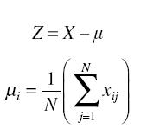
Eigen Vectors
The aim of PCA is to project the original image vector into a feature vector such that the dimensionality of the image vector is reduced.
The transformation, or the feature vector, is a vector of size n × m, where n denotes the total dimensionality of the image vector.
The vector X is the matrix of vectors in the training data set that we already have.
This vector is taken for the computation of the eigen vectors for the rest of the steps. This matrix is given by Equation 7.5. Equation 7.6 denotes the mean μi for any attribute or row of matrix X.

Slide 17

Eigen Vectors
The covariance matrix may be defined by Equation 7.7. Readers may expand this matrix in terms of individual attributes and their corresponding values in order to study the formula as a standard variance formula, which we studied earlier in this chapter.
where C is the covariance matrix. The size of matrix T is n × N, which means that the covariance matrix is a square matrix of size n × n.
This makes very scalable and high-performing systems with only a little loss of generality.
These systems make it possible to solve real-life problems in a natural way that otherwise would not have bee possible.

Slide 18

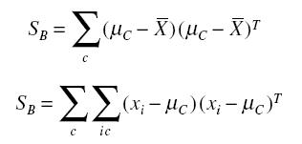
Dimensionality Reduction by R-LDA
The R-LDA is the regularized form of Fisher’s discriminant. It is a type of linear discriminant analysis (LDA).
Fischer’s LDA is a method that solves this problem by accounting for the presence of different classes in the training data set.
The basic aim of this algorithm is to maximize the value of the objective function given by Equation 7.11:
The two scatter matrices are given by Equations 7.12 and 7.13:

Slide 19


Dimensionality Reduction by R-LDA
Now we study the regularization in Fisher’s LDA. This LDA faces a serious problem known as small sample size (SSS).
The tradeoff between the variance and the bias, depending on the severity of the SSS problem, is controlled by the strength of regularization. The equation for regularization is given by Equation 7.14:
If, however, we keep the regularization parameter as 1, Equation 7.14 converts to Equation 7.15, in which there is a string effect of regularization.

Slide 20
Morphological Methods
In this section, we study how to apply the morphological methods, or the morphological analysis (MA), to the problem of face recognition, which is a highly multidimensional, complex problem to solve.
The term morphology comes from the classical Greek word morphe, which means “shape or form.” In this method, we study how the different shapes are formed, combined, and exist in any given simple or complex pattern.
The other problem is that these objects are very difficult to break down, identify, or resolve. Doing so requires additional processing and complex algorithms.
Different people may interpret this point differently. Furthermore these systems cannot be easily modeled in a meaningful way.

Slide 21
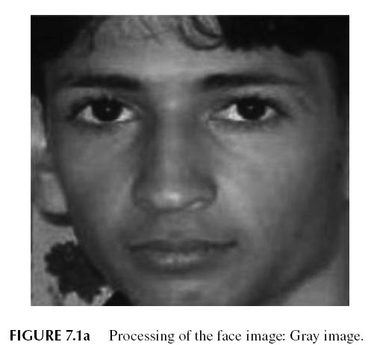
Morphological Methods
The MA comes into play for these kinds of problems. In this section, we analyze the different issues that are more or less similar for the various problems.

Slide 22
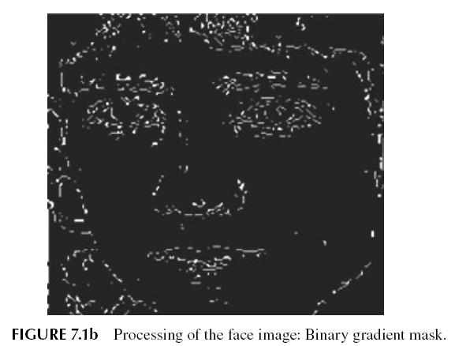
Morphological Methods
We now apply the fundamentals and principles of MA to the problem of face recognition.
The input to the system is a color image. This image is first converted to the equivalent grayscale image.

Slide 23
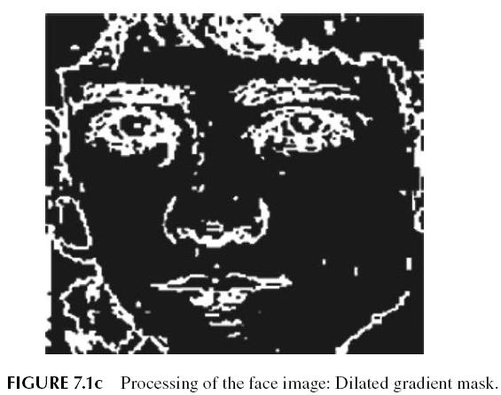
Morphological Methods
The linear gaps are removed by applying linear structuring elements, such as dilating the binary gradient image.

Slide 24
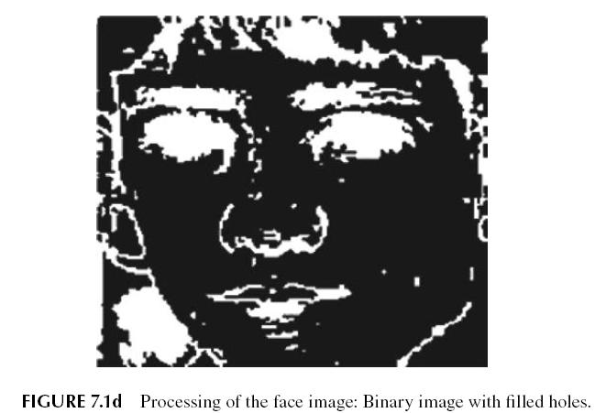
Morphological Methods
These steps enhance the various features that we were supposed to extract. The features include eyebrows, eyes, nose, and mouth.
These features are distinctly visible from the surroundings, and the unwanted background and features have been removed from the image.

Slide 25
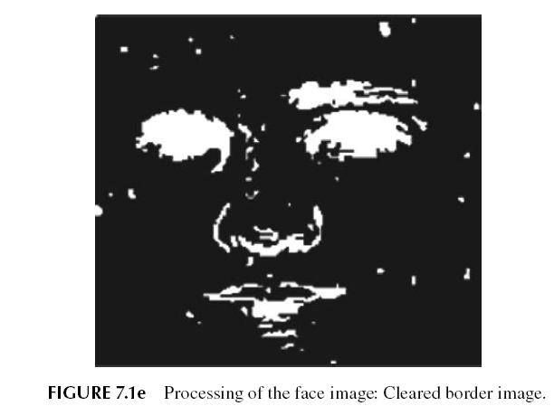
Morphological Methods

Slide 26
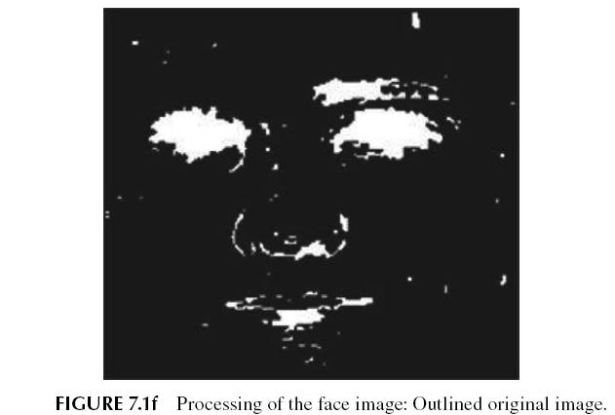
Morphological Methods

Slide 27
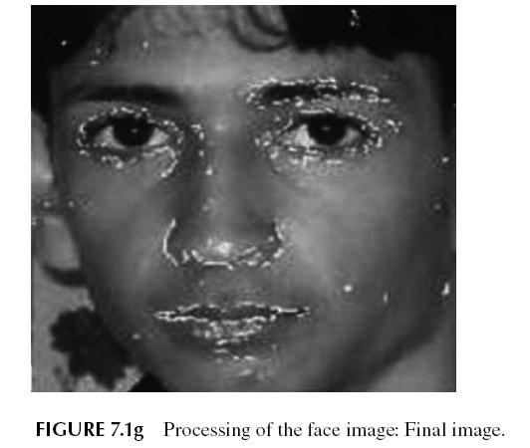
Morphological Methods

Slide 28
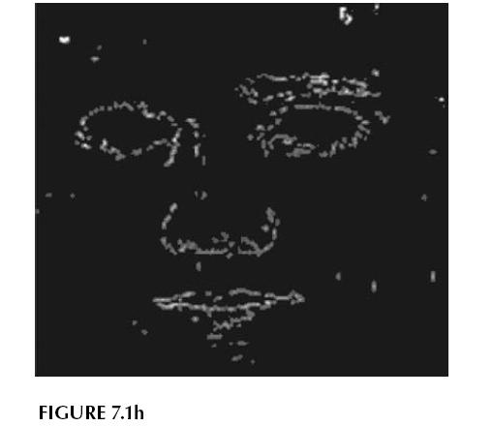
Morphological Methods

Slide 29
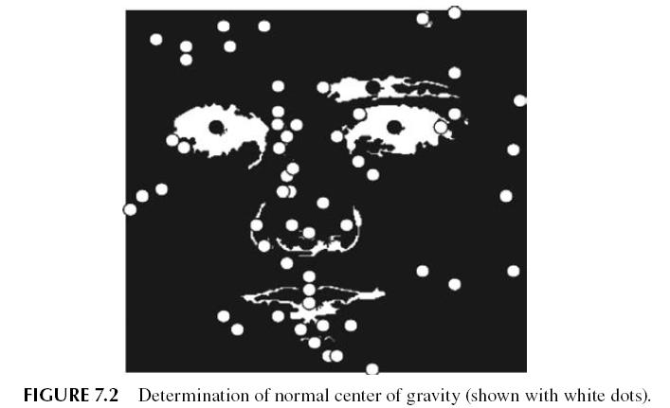
Morphological Methods
The next task is to extract the features that may be used as an input for the classifier for identification.
The number of inputs, their variations, and noise levels all play a great role in the behavior of the classifier and in the efficiency of the entire system.

Slide 30
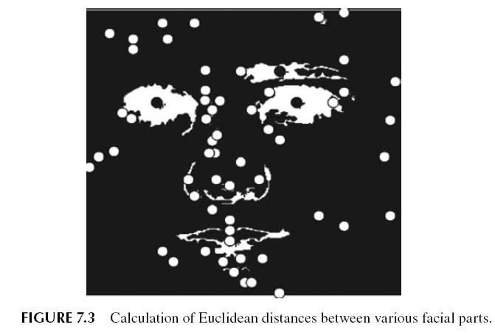
Morphological Methods

Slide 31
Classification with ANNs
The next job is classification, in which we are supposed to find the correct class to which a given input belongs. In other words, we need to find the correct person whose face has been given in the database.
The system’s outputs are based on a classification model in which there are as many outputs as there are classes. Each output denotes a class.
Hence whenever we apply any input, the system gives us n number of outputs.
The inputs and outputs are common to both the ANN with BPA and the RBFNs. We now discuss each one with regard to the problem.

Slide 32
The ANN with BPA
The ANN with BPA is the first classifier we use over the problem. This classifier performs the task of classification by generalizing the class and the class boundaries.
To understand the role of ANN with BPA in classification, consider the input space. The inputs and outputs are plotted in the form of a graph.
If the number of neurons is far too many, the ANN will be very sensitive. This would enable it to make very rapid or sharp transitions in very little space, due to the flexibility introduced by the large number of system parameters.
This inhibits a very sensitive structure. Note that a very sensitive structure is highly unlikely, because the ANN can now imitate anything one imagines; hence the performance in the unknown inputs is very bad.

Slide 33
RBFN
The radial basis function network is the second classifier that we implement. Unlike the ANN with BPA, which we saw is highly generalized, a different role is played by these ANNs.
RBFNs select some training data sets, which act as the guides for the rest of the training and testing data.
The output to these guides or data centers can be assumed to be perfect. These guides are spread all across the input space.
Hence the localized nature of the algorithm may be easily seen. The output is mainly dominated by the guides that are very close to the input.
This makes the system an excellent choice for classification problems.

Slide 34
Results
To test the system, all the discussed feature extraction methods, as well as the classifiers, were implemented and tested over the grimace face database.
This database contains 360 color face images of 18 individuals, with 20 images per person.
The database has images that vary in emotions, lighting, and position.

Slide 35
PCA, R-LDA , and MA with ANN and BPA
For the PCA and R-LDA, 180 images (50%) were selected for the training data set and 180 images (50%) were selected for testing.
These corresponded to 5 images per person out of the 10 images available.
For MA, 120 images, corresponding to 8 for each person, were used for training and the remaining 120 images were used for testing.
The configuration of ANN with BPA for these methods, used for training and testing, is shown in Table 7.1.
Training graphs of ANN with BPA applied to the PCA and R-LDA preprocessed training set are shown in Figures 7.4 and 7.5. The results with the use of ANN and BPA ar given in Table 7.2.

Slide 36
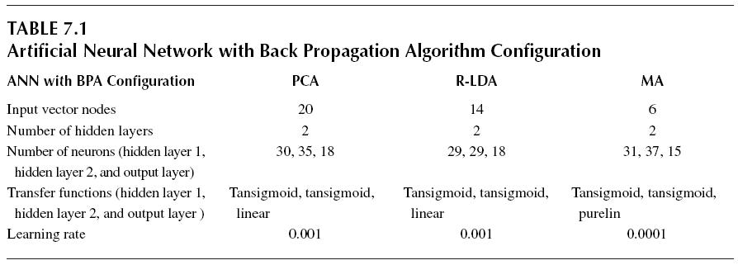
PCA, R-LDA , and MA with ANN and BPA

Slide 37
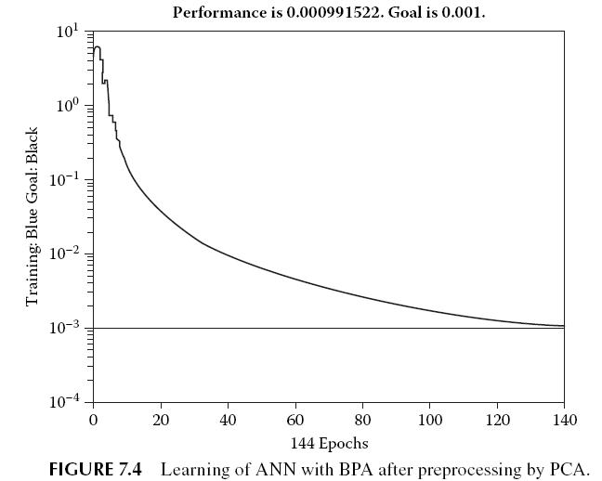
PCA, R-LDA , and MA with ANN and BPA

Slide 38
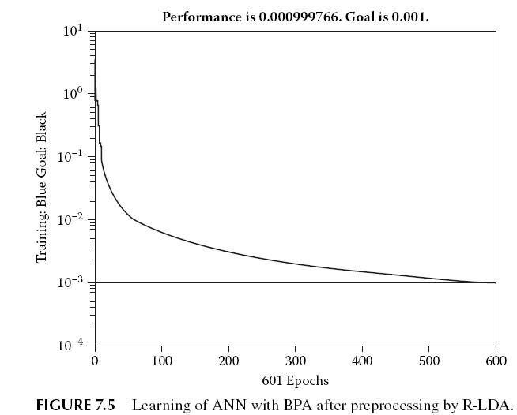
PCA, R-LDA , and MA with ANN and BPA

Slide 39
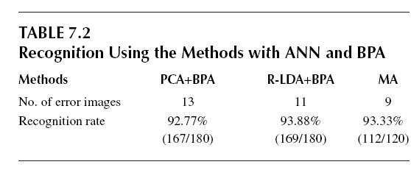
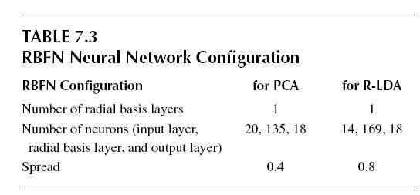
PCA, R-LDA , and MA with ANN and BPA

Slide 40
PCA and R-LDA with RBFN
The inputs were same with RBFN as they were for ANN with BPA. The configuration of RBFN with PCA and R-LDA, used for training and testing, is shown in Table 7.3.
The results from the use of RBFN with PCA and R-LDA are given in Tables 7.3 and 7.4.
Each ANN took a different amount of time for training input feature vectors. Training of the RBFN was faster as compared with ANN with BPA.
This shows that a localized ANN performed better, which is usually expected in a classification problem because of its localized nature.

Slide 41
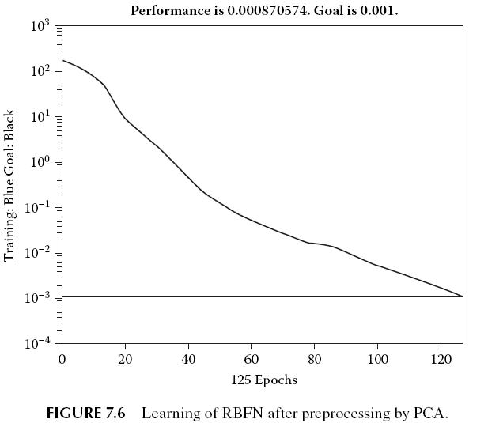
PCA and R-LDA with RBFN

Slide 42
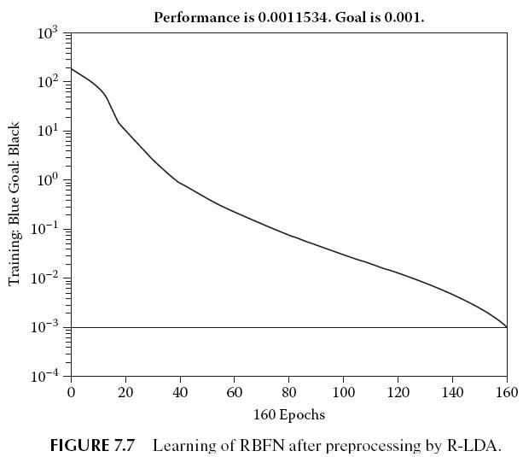
PCA and R-LDA with RBFN

Slide 43
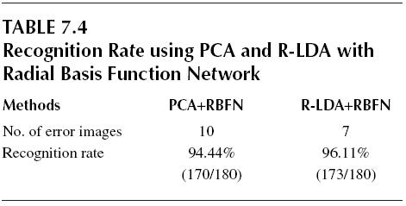
Conclusion Remarks for Face as a Biometric
In this section, we discussed three important feature extraction techniques—PCA, R-LDA, and MA. These techniques extracted features from the face. The extracted features were then used on two classifiers—ANN with BPA and RBFN.
Furthermore the MA was independent of expression, lighting, or other conditions and gave good performance in the presence of these factors.

Slide 44
Hand Geometry
Hand geometry is usually difficult to visualize as a means of identification, because humans do not usually use this as a feature for recognizing another person.
The basic approach in this section is as in the previous section. We will first discuss some techniques for preprocessing and feature extraction.
Here we deal with the problem of verification, which means we need to verify the claimed identity of the person.
We can make two decisions. One is that the claimed identity is correct, and the other is that the claim is false.
The hand is a very interesting biometric feature. The input in hand geometry may be taken by the use of scanners.

Slide 45
Hand Geometry
One of the major differences between the palm and the face is in dimensionality. As compared with face, the hand represents a biometric feature of lower dimensionality.
Geometrically significant landmarks are extracted from the segmented images of the palm. These are used for hand alignment and for the construction of recognition features.
For the classification of the extracted data, we use ANNs with BPA. These networks, as discussed in the previous section, can be modeled to work with classification problems.
The hand-recognition biometric has a very special domain of application. Very distinctive biometrics, such as fingerprints and iris, may not be acceptable.

Slide 46
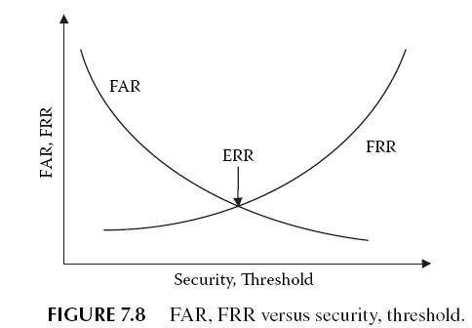
Hand Geometry
Furthermore hand geometry is ideally suited for integration with other biometrics—in particular, fingerprints.
For instance, an identification and verification system may use fingerprints for (infrequent) identification and may use hand geometry for (frequent) verification.

Slide 47
Hand Geometry
To measure the effectiveness of any identification system, we must measure two standard errordenoting metrics: false rejection rate (FRR) and false acceptance rate (FAR).
The way to control these factors is by changing the system parameters. Two major parameters may be changed.
Hence it is clear that FAR and FRR are inversely related. If we were to plot a graph between these factors with respect to the security or the threshold, it would be as shown in Figure 7.8.
We now discuss each step involved in the process of identification in hand geometry. Per our methodology of the recognition systems, we will first study image acquisition.
Then we will discuss image preprocessing and feature extraction.

Slide 48
Image Acquisition
The first task that needs to be performed is image acquisition. This step comprises a light source, a flat-bed scanner, and a black flat surface used as a background.
The user can place his hand freely, without the need of pegs to fix the hand’s position.
During scanning, we must ensure that the subject’s fingers do not touch one another and that the hand lies flat and stays on the flat surface of the scanner. The scanner scans the image of the hand.
The image captured is a 640 × 480 pixel color photograph in JPEG format. Only the right hand images of users are acquired.

Slide 49
Image Preprocessing
We follow more or less the same procedure for image processing that we used for the face.
The given image is a color image. Hence we first convert it into a grayscale image. This allows us to work better with the image.
Filtering
A median filter is applied to remove noise in the image.
Binarization
We convert the image into a pure black-and-white image such that the hand is white and all other backgrounds are black.

Slide 50

Binarization
To do this, we follow the mechanism of thresholding, in which all pixels above a threshold value are assigned white and the rest are assigned black. This is given by Equation 7.16:
where I’ denotes the black-and-white image and I denotes the original gray image.
The threshold value is automatically computed using Otsu’s method. Then the border of the hand’s silhouette is smoothed using morphological opening and closing.
Therefore, the image’s histogram is bimodal. The result is shown in Figure 7.9.

Slide 51
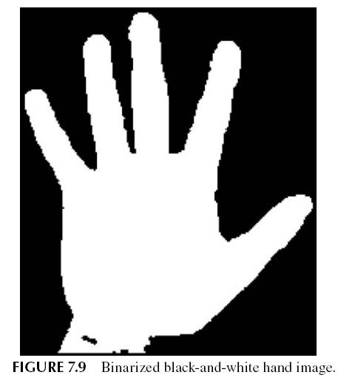
Contour Detection
The next task is to find out the contour between the hand and the background. This effectively separates the hand from the background.

Slide 52
Feature Extraction
The next step is to extract the features from the obtained image vector. We extract the good features from the image.
To extract these features, we must locate the landmark points in the given image vector. These points will enable us to easily extract the various features needed.
To calculate the landmark points, or the fingertips and valley points, we first find a reference position in the given image.
Comparing the distances with those of other neighboring points on the hand contour, the fingertips are the points that have the most distance, and the valley points, the least.
The extracted features used here are the lengths of each finger and the widths of each finger at three locations.

Slide 53
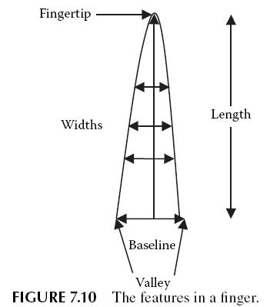
Finger Baselines
The baselines are the lines that connect the finger valleys. We first create the baseline for the middle finger; this is the line connecting the second and third valley points.
Thus, the other valley points are assumed to be on the opposite side of the finger in such a way that its distance from the fingertip is the same as that of the known valley point and the fingertip.

Slide 54
Finger Lengths
The finger lengths are measured as the distance between the fingertips to the middle points of the finger baselines. These finger lengths are shown in Figure 7.10.
Finger Widths
Finger widths are the widths of a finger measured at three locations, as shown in Figure 7.10.
The first is measured at the middle of the finger length; the second, at one-third the finger length; and the last, at two-thirds the finger length.

Slide 55

Classification by ANN
In this problem, we use ANN with BPA as a classifier in a similar manner that we used in face recognition.
Thus the ANN has a single output that denotes the confidence of the ANN of the applied input being the correct person.
Let us consider that the output of the ANN is o. Let t be the threshold. The system output is always 1 or 0, where 1 denotes that the person is genuine and 0 denotes that the person is a fraud. The system output may be given by the Equation 7.17:
Using this equation, we may verify the identity of every individual in the database.

Slide 56
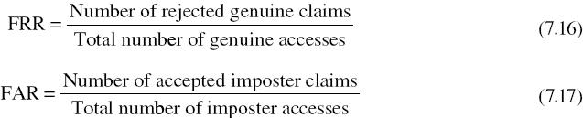
Results
The system was trained and tested against a database that consisted of 61 users. For each user, multiple scans of hands were collected for both the left and the right hands.
The features extracted for some of the people are shown in Table 7.5. There are a total of 13 features, from L1 to W8. The explanation of these features is given in Figure 7.11.
The system performance is measured against the standard FRR and FAR ratios as given by Equations 7.16 and 7.17:

Slide 57
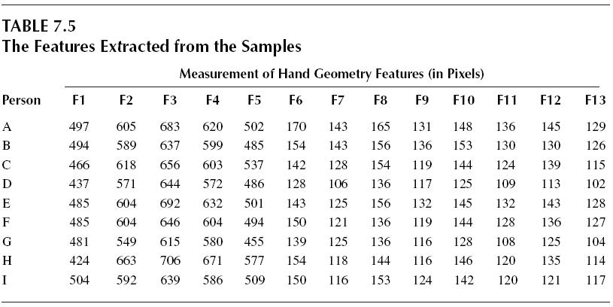
Results

Slide 58
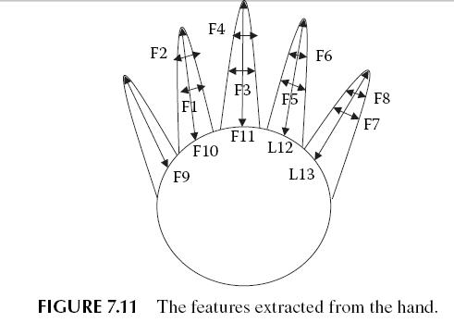
Results

Slide 59
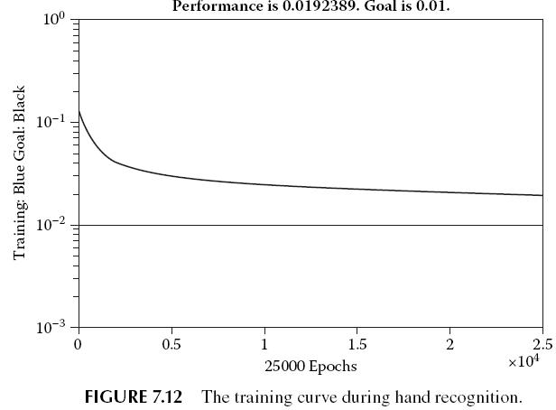
Results
The built system was tested. The FAR for the system came out to be 4.2828, and the FRR came out to be 4.0000.

Slide 60
Concluding Remarks for Hand as a Biometric
In this section, we discussed a good means of using a biometric identity for the purpose of verification.
Hand geometry was used as a novel and unconventional way of verification. In this system, the hand images were scanned and were used for the extraction of various features.
To test the system, the images of 61 users were scanned, with multiple images per individual. Using these images as inputs, the features were extracted, and the resulting system was tested using ANN with BPA.
The present system offered a set of good features that were extracted for the given system. The other biometric features may be explored in the future.
In addition, the fusion of hand geometry with fingerprinting or any other recognition system may be implemented.

Slide 61
Iris
The third biometric identity we discuss is the iris. The iris has always been a source of attraction for people.
In this section, we study the iris, which happens to be one of the most integral parts of the eye. The biomedical literature suggests that irises are as distinct as fingerprints or patterns of retinal blood vessels.
The immense identification potential in the human iris is clear from the fact that a study of more than two million different pairs of human irises shows that no iris patterns were identical in even as much as one-third of their form.
It is easy to imagine why the iris is so good for identification. Imagine seeing someone you know whose face was covered except for the eyes.

Slide 62
Iris
Iris recognition faces various problems that make it difficult for the classifier to make verification.
In this case, detection of the corner is used as a means of extracting the features from the human iris. We use a mechanism known as the canny edge detection scheme to detect the iris in the eye’s digital image.
The two iris images belong to the same person if the number of matched corners is greater than the threshold value.
In this section, we study the iris in detail and discuss the various features that make good inputs for identification and verification.

Slide 63
The Human Iris
In this section, we give a brief description of the human eye. Much of the terms discussed in this section are only for the general awareness of readers. We will not be requiring these terms for the recognition of the iris.
The iris is a thin circular diaphragm that lies between the cornea and the lens. The various characteristics in the human eye are shown in Figure 7.13.
The iris consists of a number of layers. The lowest layer is called the epithelium, which contains dense pigmentation cells.
The iris surface may be divided into two zones that may be easily differentiated by their color. The outer zone is the ciliary zone, and the inner zone is the pupillary zone.

Slide 64
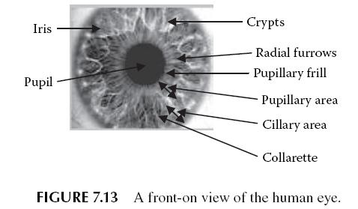
The Human Iris
Formation of the iris begins during the third month of embryonic life. In the first year of life, the unique pattern on the surface of the iris is formed.
As can be observed, the human eye has numerous distinctive features that may easily be used for identification purposes.
Thus the iris is a natural choice for biometric identity. This, however, also requires special capturing of the eye from a close vicinity.

Slide 65
Image Acquisition
The iris is extracted from the image taken of the human eye. For this we use a camera that is placed at an approximate distance of 9 cm from the user’s eye.
The distance between the user and the source of light is preferred to be about 12 cm.
The image that is taken must have good resolution and sharpness and must be under good lighting conditions.
These features play a more important part as compared with face, due to the nature of the iris.

Slide 66
Preprocessing
The image requires preprocessing. We apply various operations to the image in order to extract the necessary features.
Here we make use of the canny edge detection algorithm. This algorithm first makes the image smooth by applying a Gaussian filter.
Then we apply nonmaxima suppression to the gradient magnitude. Finally we use a double-thresholding algorithm to detect and link edges.
The details of this operator are, however, beyond the scope of the book.

Slide 67
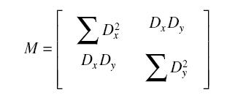
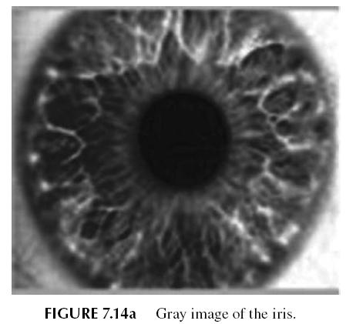
Feature Extraction
We use a window matrix of size 3 × 3 that is circulated in the entire image. This determines whether any point is a corner point. The covariance matrix M is given by Equation 7.18:

Slide 68
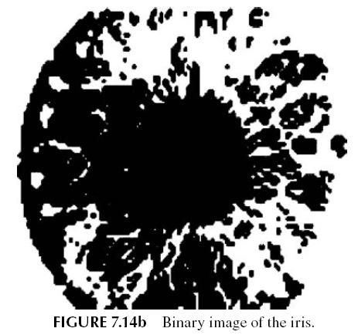
Feature Extraction

Slide 69
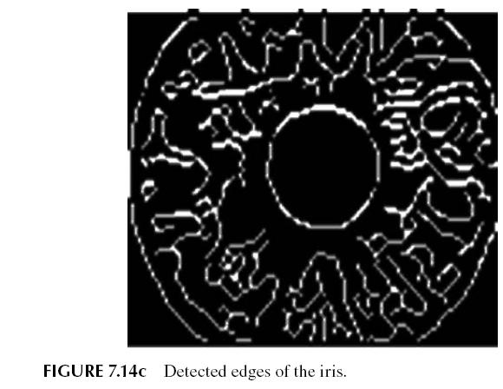
Feature Extraction

Slide 70
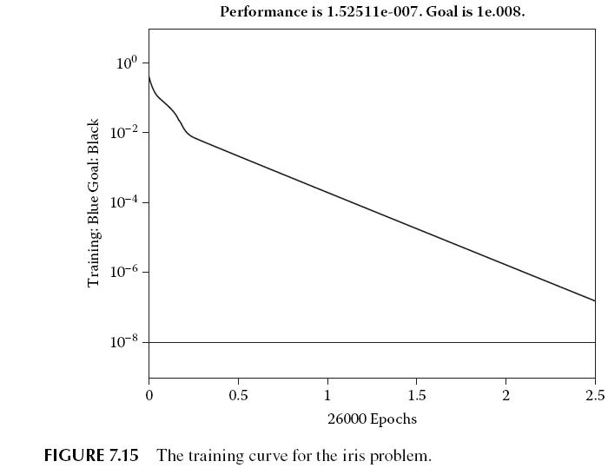
Feature Extraction
where Dx is the change in intensity when measured along the columns and Dy is the change in intensit when measured along the rows.

Slide 71
Results
The system was trained using a database of 120 individuals whose eyes had been captured with the help of a camera.
This database was used by the system for verification purposes. MATLAB functions were used for the various image-processing tasks to extract the features.
The values of the threshold were fixed by trial and error in order to give the least errors to both FRR and FAR.
These are acceptable errors in the system and prove that the system was able to carry out the task with acceptable accuracies.

Slide 72
Conclusion Remarks for Iris as a Biometric
In this method, we mainly followed an approach similar to that used for both the hand geometry and the face recognition.
The system used the corner detection approach to find the corners in the image of the eye. These extracted corners were the features that the ANN was trained with.
When we applied these mechanisms over the database of irises, we got an acceptable FRR and FAR, which shows that the iris can be used as a good biometric identity.
The placement of cameras is a potential problem in iris verification. Also eyelids pose a serious limitation to the system, restricting its efficiency.

